Slide 1

EEGLAB introduction
Arnaud Delorme, PhD

Slide 2
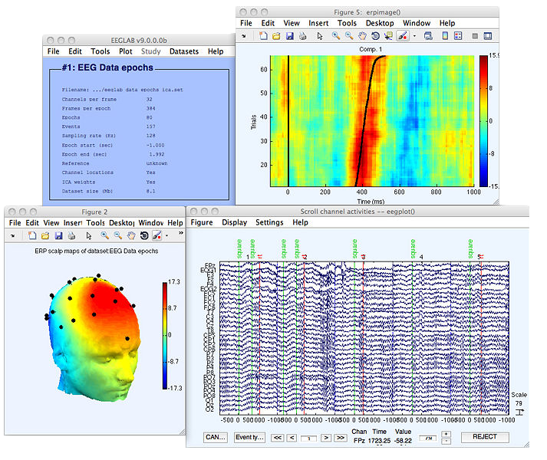
EEGLAB History Timeline
1997
2001
2003
2006
2011
2018
2021
2024
1st EEGLAB for artifact rejection (Salk Institute)
EEGLAB plug-ins, STUDY structure
EEGLAB STUDY use single trial and LIMO integration
Automation on Cloud platforms
EEG/ICA Toolbox (Salk Institute)
EEGLAB issued to wide audience (Salk Institute) and NIH support
EEGLAB, the most widely used EEG research environment
BIDS integration, big data pipelines,
New website
Notes:
© Copyright PresentationGO.com – The free PowerPoint and Google Slides template library

Slide 3
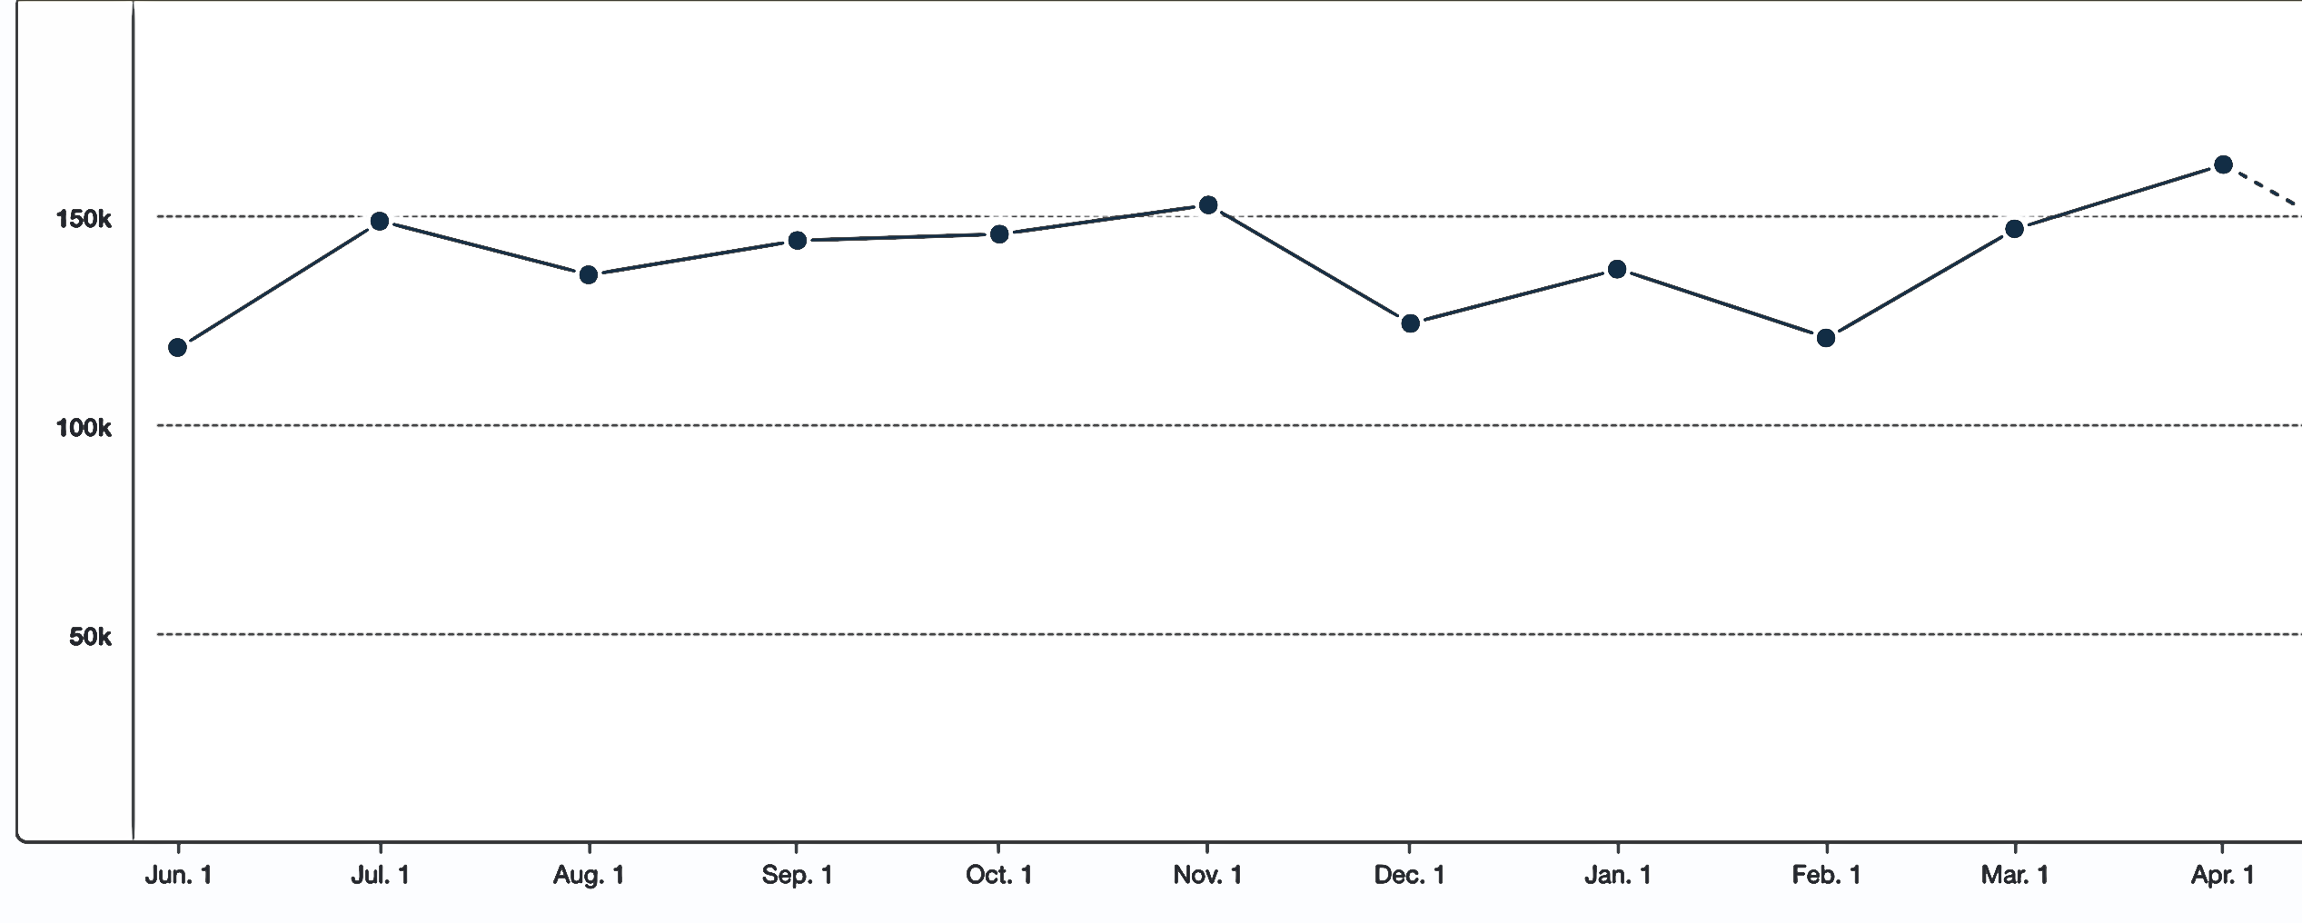
EEGLAB in a few numbers
About 600 functions (150 000 lines of code)
About 400,000 download over the past 10 years
15,500 users on the diffusion list
Supporting 423 million of dollars of research as of 2022
NIH funding since 2003
151 plugins
140,000 EEGLAB session/month (mixpanel)

Slide 4
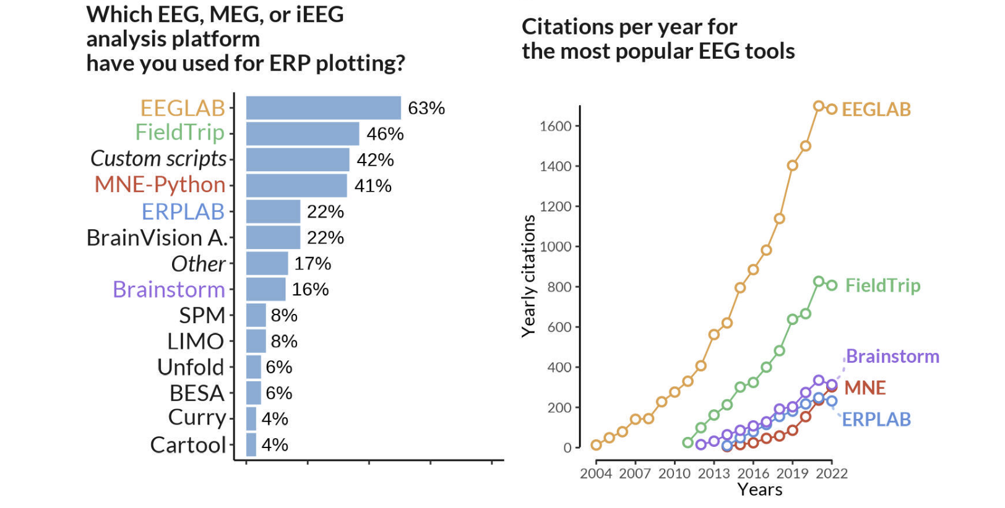
Mikheev V, Skukies R, Ehinger BV. The Art of Brainwaves: A Survey on Event-Related Potential Visualization Practices. Aperture Neuro. 2024;4. doi:10.52294/001c.116386

Slide 5
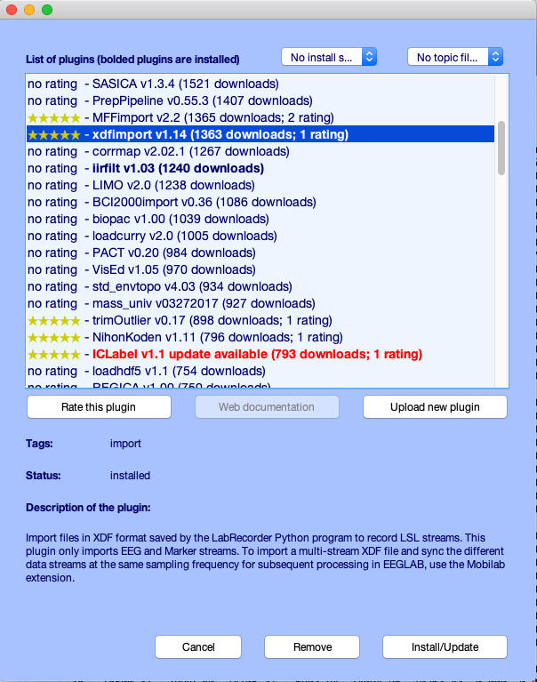
EEGLAB plugin manager (151 plugins)

Slide 6
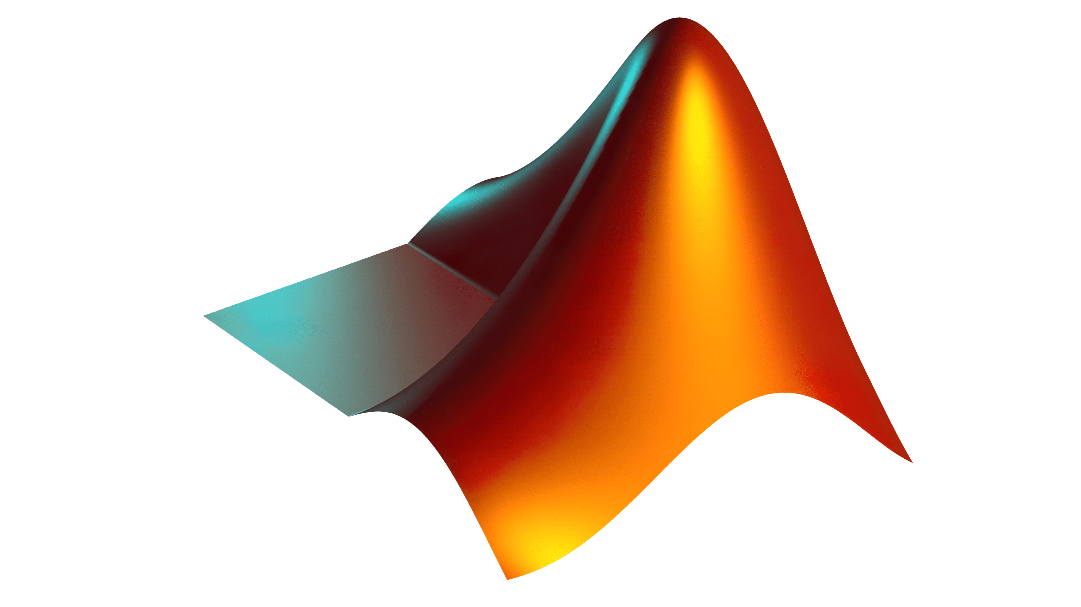

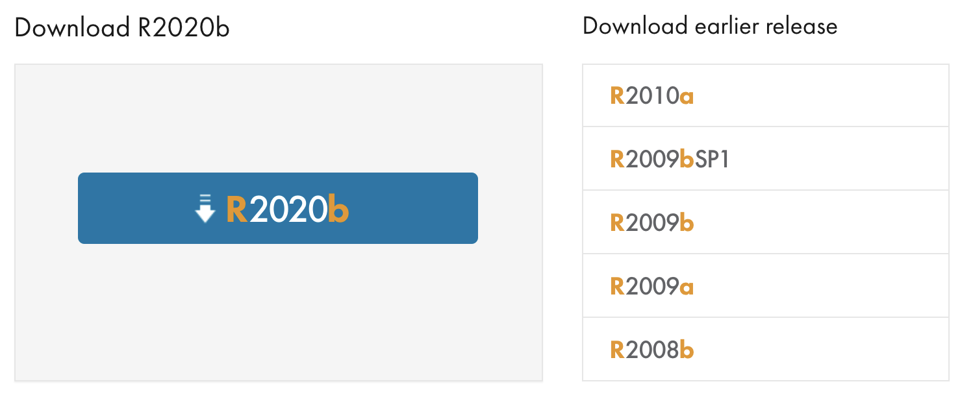
Which MATLAB version?
Additional MATLAB toolboxes
Signal processing toolbox
Statistics toolbox
Optimization toolbox
Image processing toolbox

Slide 7
Matlab based open source
Pros
Easy to program, highly modular and extendable
Not dependent on any platform (64-bit) and highly optimized
Large community of users (latest development in signal processing research)
Powerful scripting capabilities
Cons
Matlab commercial license required
Matlab commercial toolboxes recommended (signal processing, statistics)

Slide 8



Which Operating System?

Slide 9
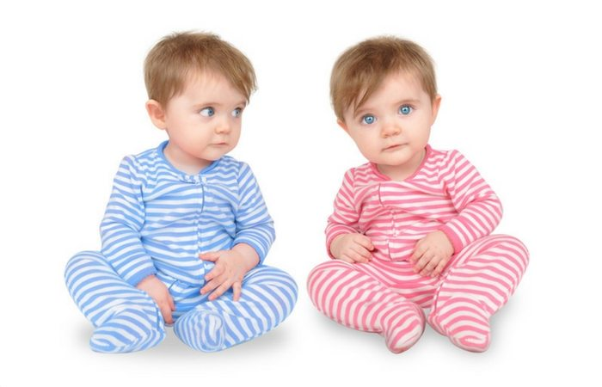
EEGLAB on MATLAB
vs EEGLAB compiled

Slide 10
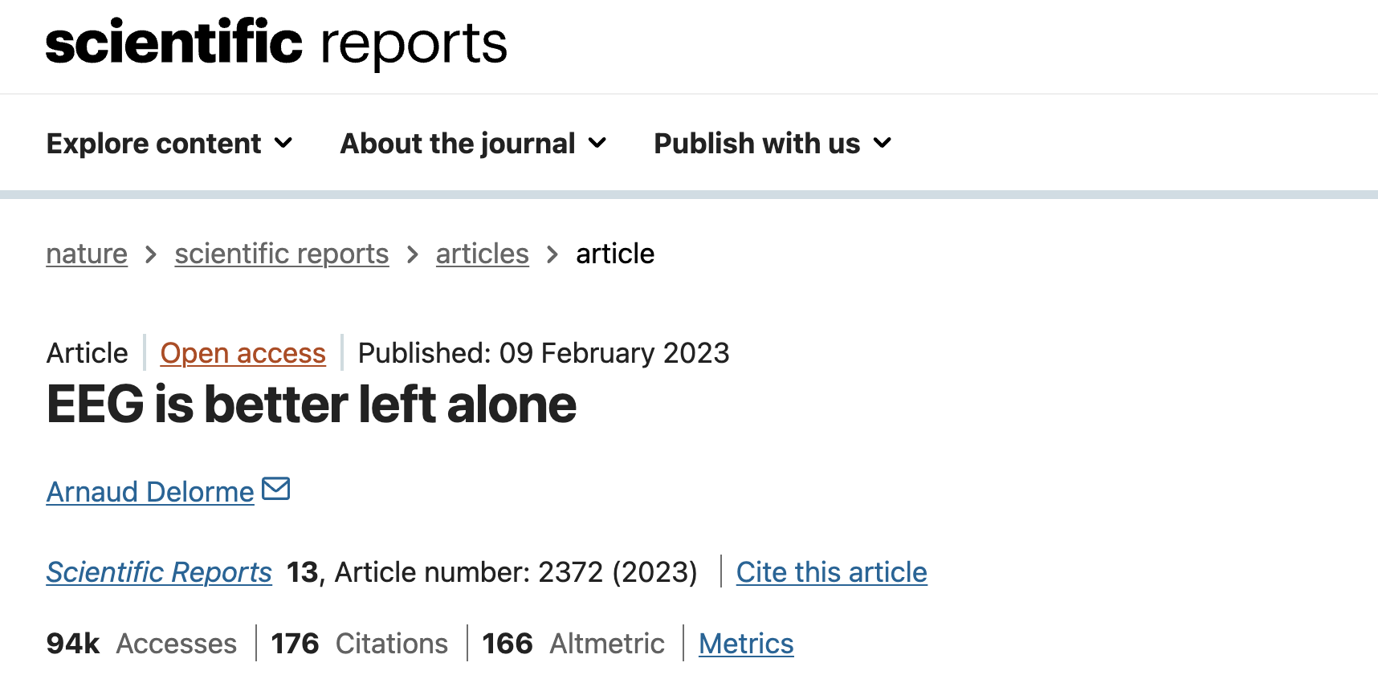
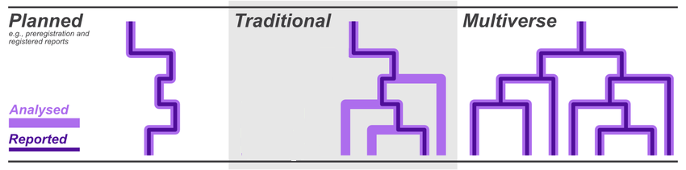

Slide 13
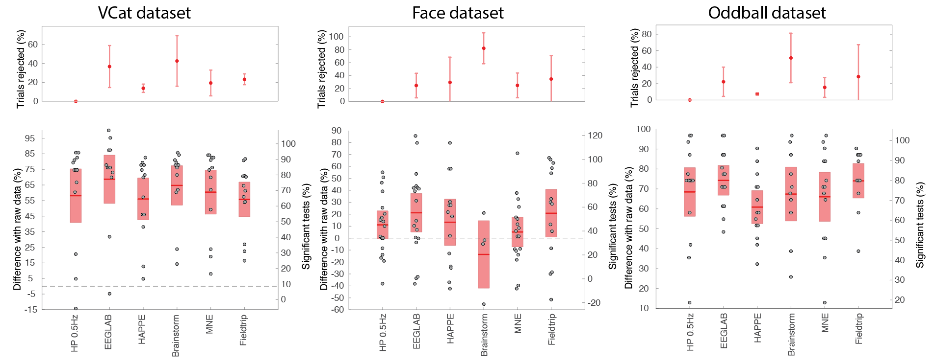
Is there an optimal preprocessing pipeline?
Each automated artifact rejection optimized (EEGLAB, MNE, Brainstorm, Fieldtrip)

Slide 14
Is there an optimal preprocessing pipeline?
Each automated artifact rejection optimized (EEGLAB, MNE, Brainstorm, Fieldtrip)
Compared to high-pass at 0.5Hz, not much improvement of any pipeline (although EEGLAB pipeline the only one significantly superior to 0.5 Hz high pass for all 3 datasets – no other pipeline superior to 0.5 Hz high pass for any dataset)
EEGLAB minor advantage due to line-noise contaminated channel interpolation and ICA automated rejection

Slide 15
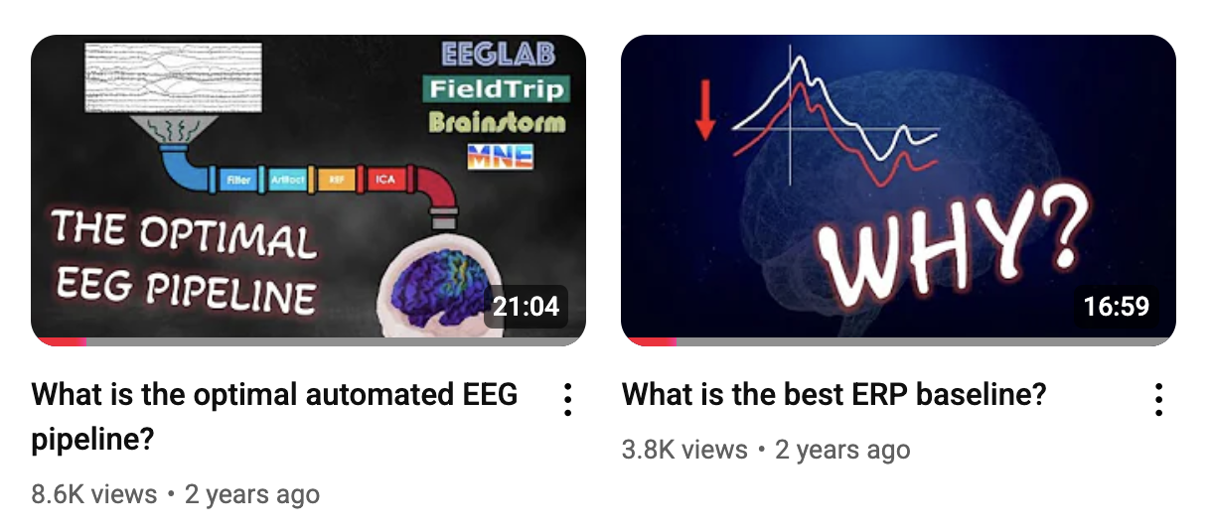
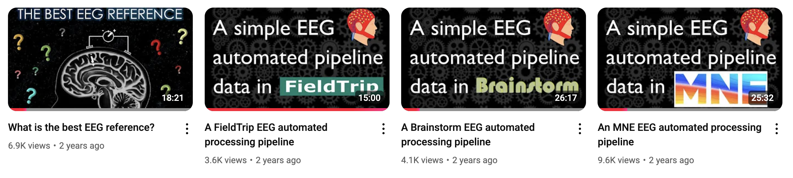
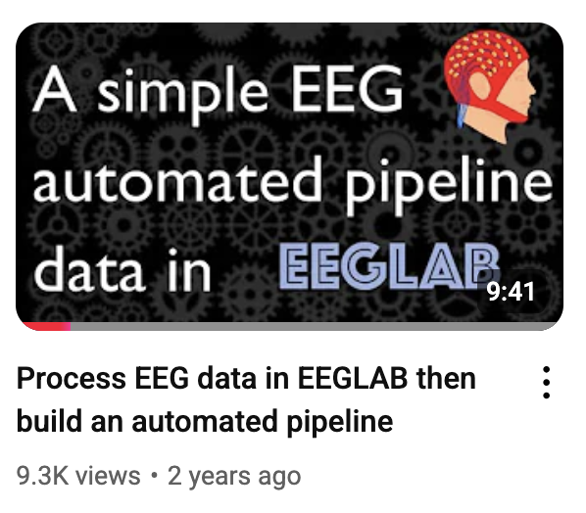
YouTube videos

Slide 16
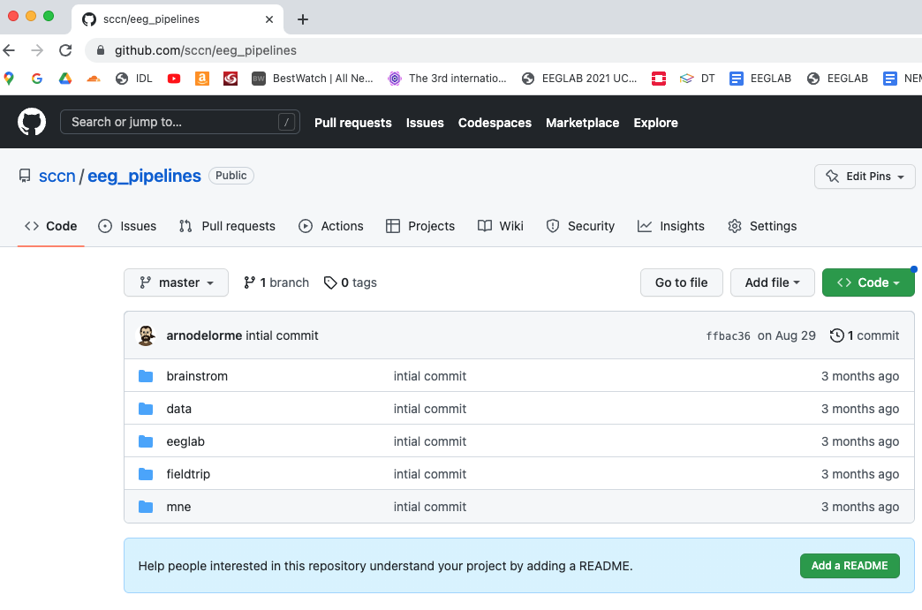
Automated pre-processing pipelines available
Has test data
Please comment and help improve the automated pipeline for each software

Slide 17
EEGLAB reference articles
Delorme, A., Makeig, S. (2004) EEGLAB: an open source toolbox for analysis of single-trial EEG dynamics including independent component analysis. Journal of Neuroscience Methods, 134(1), 9-21.
Makeig, S., Debener, S., Onton, J., Delorme, A. (2004) Mining event related dynamics. Trends in cognitive Neuroscience, 8(5), 204-210.
Delorme, A., Mullen, T., Kothe, C., Bigdely-Shamlo, N., Akalin, Z., Vankov, A., Makeig, S. (2011) EEGLAB, MPT, NetSIFT, NFT, BCILAB, and ERICA: New tools for advanced EEG/MEG processing. Computational Intelligence, article ID 130714.
Delorme, A., Kothe, C., Bigdely, N., Vankov, A., Oostenveld, R., Makeig, S. (2010) Matlab Tools for BCI Research? In "human-computer interaction and brain-computer interfaces". Editors : Tan, D. and Nijholt, A. Springer Publishing.
Delorme, A., Makeig, S. (2009) Open Source Programming for Interpreted Language: Graphic Interface and Macro Bridging Interface. 2009 Fifth International Conference on Signal-Image Technology & Internet-Based Systems (SITIS, indexed in IEEE), Nov. 29 2009-Dec. 4 2009, 430-434.
Delorme, A., Palmer, J., Onton, J., Oostenveld, R., Makeig, S. (2012) Independent EEG sources are dipolar.PLoS One, 7(2).
Delorme, A., Miyakoshi., M., Jung, T.P., Makeig, S. (2014) Grand average ERP-image plotting and statistics: A method for comparing variability in event-related single-trial EEG activities across subjects and conditions. J Neurosci Methods. 2014 Oct 22. pii: S0165-0270(14)00363-X. doi: 10.1016/j.jneumeth.2014.10.003

Slide 18

Get ready
1. Install instructions: https://forum.cuttingeeg.org/tag/eeglab
2. Data (ask for the flashdrive)
Download the pruned dataset (ds000117_pruned)
Download group dataset (ds002718)
3. Install git (Windows Git-bash; Linux or Osx 😇)
4. Clone EEGLAB: https://github.com/sccn/eeglab (see README) or use flashdrive
Start MATLAB then EEGLAB
(use plugin manager menu item File > Manage EEGLAB extensions)
Install File-IO plugin
Install Fieldtrip-lite plugin
Install picard plugin
5. Clone slides and script repository from https://github.com/sccn/practical_MEEG2025

